Slide 1
COM1302-Database Management Systems
Database Architecture and Data models

Slide 2
Sub Topics
What is database Architecture?
Basic-Client server Architecture
Data models
Relational Model

Slide 3
Database architecture
The database architecture is the set of specifications, rules, and processes that dictate how data is stored in a database and how data is accessed by components of a system.

Slide 4
Basic Client-Server Architectures
Specialized Servers with Specialized functions
Clients
DBMS Server

Slide 5
Clients
Provide appropriate interfaces and a client-version of the system to access and utilize the server resources.
Clients maybe diskless machines or PCs or Workstations with disks with only the client software installed.
Connected to the servers via some form of a network. (LAN: local area network, wireless network, etc.)

Slide 6
DBMS Server
Provides database query and transaction services to the clients.
Called as query and transaction servers.

Slide 7
Database Architecture
Database architecture divided into two types
Logical 2 tier client server architecture
Logical 3 tier client server architecture

Slide 8
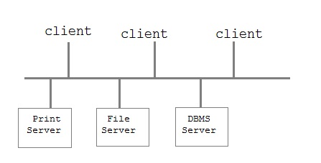
Two tier client server architecture
Is used for user interface programs and application programs that run on client side.

Slide 9
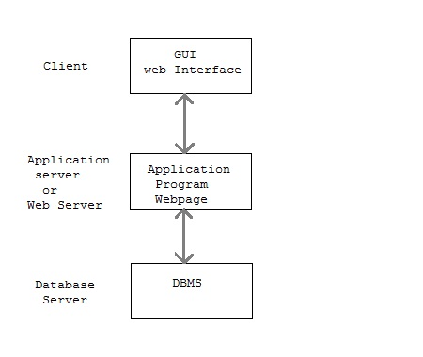
Three tier client server architecture
This is used in web application

Slide 10
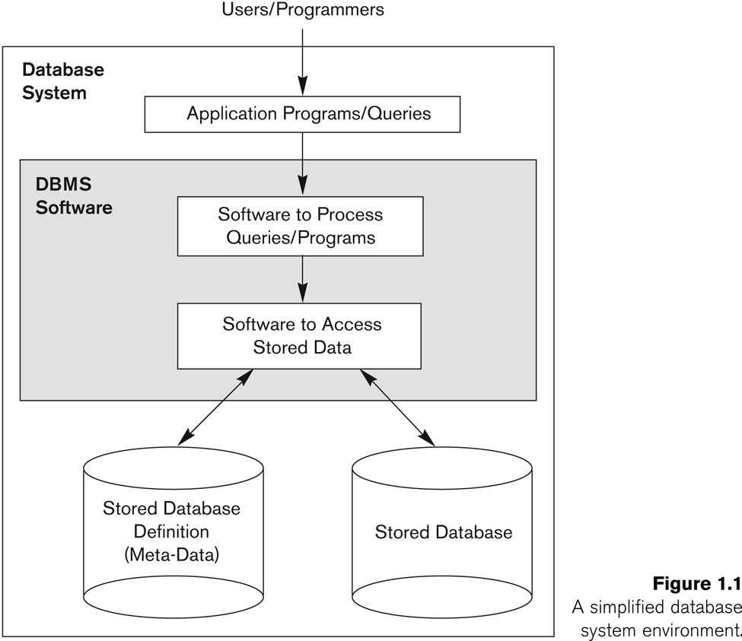
A simplified database system environment

Slide 11
What do we store in a Database?
Collection of data central to some enterprise
Essential to operation of enterprise
Historical data can guide enterprise strategy
Of interest to other enterprises
State of database mirrors state of enterprise
How do we store data?

Slide 12
Data Models
Data Model: A set of concepts to describe the structure of a database and certain constraints that the database should obey
Many forms of data models
Makes data abstraction possible
Hides details of physical data storage from the user
Most commercial database systems are based on relational data model
Notes:
Structure means data types, relationships, and constraints that always hold for the data

Slide 13
Database (Implementation) Models
Hierarchical
Network
Relational
Object-oriented

Slide 14
Hierarchical Model
Represents a hierarchy with the whole at the root and the components forms the child nodes in turn
Thus, all the components or the nodes, taken together form the whole

Slide 15
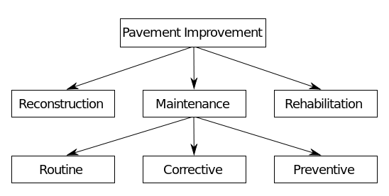
Hierarchical Model

Slide 16
Network Model
Resembles the hierarchical model with a provision for a record to have more than one parent
An owner record is equivalent to a parent, and a member record s equivalent to a child in the hierarchical model
The difference is that a record can appear as a member in more than one set

Slide 17
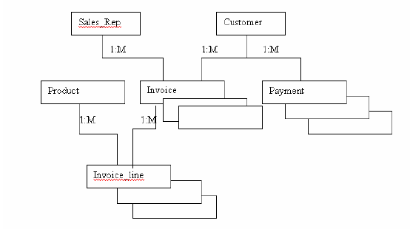
Network Model

Slide 18
Relational Model
They can manipulate and stored as relations → relational database
Relational database system devised by Codd in 1970
An attempt to devise a standard model with a sound mathematical basis
Most successful & better model than other database model
SQL query language uses for querying the data
Examples include:
Oracle, Microsoft Access, FoxPro, MySql, SQLServer etc
Notes:
The relational model is different to previous models in that it is based on mathematical set theory which gives it a rigorous structure, as defined above. These rules allow standard use of any system which claims to be relational and has led to their success, and the success of their most used query language SQL. In the next couple of slides we show a simple example relational database and then show some simple queries after introducing briefly SQL, which you will start learning in tutorials.

Slide 19
“Relations”
Can be represented as tables in which rows represent “tuples” and columns represents attributes
A relation may be described by its name and the related attributes
Eg (Employee (Emp_no, Emp_ name, Age, Start_date, Address……. )

Slide 20
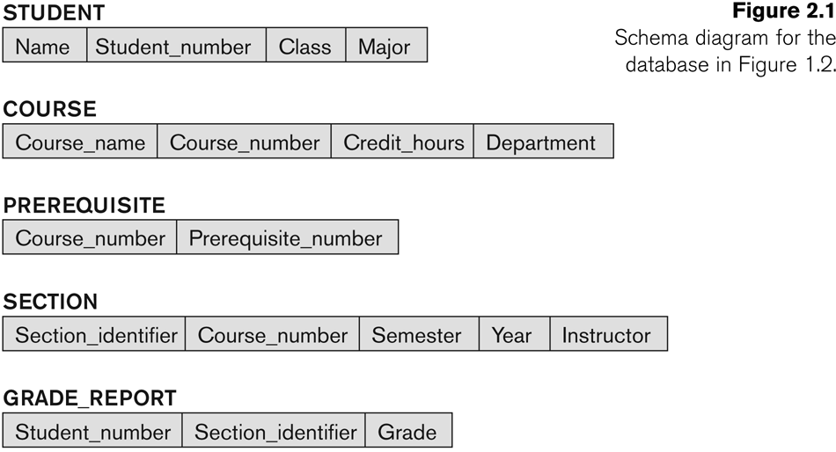
Relational Database - Example
Exists
Has
Has
Has

Slide 21
Features of Relational DBMS
2-D tables (rows and columns representing records/tuples and fields/attributes)
Dynamic links among tables
Easy and flexible to design and use
Data independence
Generic manipulation language (SQL)

Slide 22
Storing Data in a DBMS (contd)
In relational data model, the main construct is a relation.
A relation has fields that belong to it which contain the name & data type of each field
A description of data in terms of a data model is called the schema.
Every relation has a schema, which describes the name of the relation, name of each attribute (field or column), and the type of each column.
e.g.
Students(sid: string, name: string, login: string,
age: integer, gpa: real)
First Year
22
Notes:
Introduce the basic components of a database design by examining several scenarios:
A car dealer’s service department: Each car is owned by one customer. Each customer can own one or more cars.
A library’s loan desk: Each client may borrow one or more books at a time. Each book can be borrowed by more than one client
\Note: As you discuss the library’s loan desk database environment, emphasize that each loan involves one client and one or more books. At that point, a book is borrowed by one client and no other client can borrow that book. But the book will – one would hope – be returned after some time, at which time it is available to another client. Therefore, there is a M:N relationship between CLIENT and BOOK. Clearly, the time element plays a role in this relationship

Slide 23
Schemas versus Instances
Database Schema: The description of a database. Includes descriptions of the database structure and the constraints that should hold on the database.
Schema Diagram: A diagrammatic display of (some aspects of) a database schema.
Schema Construct: A component of the schema or an object within the schema, e.g., STUDENT, COURSE.
Database Instance: The actual data stored in a database at a particular moment in time. Also called database state (or occurrence).

Slide 24
Database Schema Vs. Database State
Database State: Refers to the content of a database at a moment in time.
Initial Database State: Refers to the database when it is loaded
Valid State: A state that satisfies the structure and constraints of the database.
database schema : changes very infrequently.
database state : changes every time the database is updated.

Slide 25
End

